Slide 1
ENGLISH LANGUAGE TEACHING
Prepared by,
B.JARINABEGAM M.A;M.PHIL;
DEPARTMENT OF ENGLISH
JAMAL MOHAMED COLLEGE

Slide 2
AIMS AND OBJECTIVES OF TEACHING ENGLISH
To enable the students to understand English when spoken
To enable them to speak English
To enable them to read English
To enable them to Write English

Slide 3
FACTORS OF TEACHING ENGLISH
THE CURRICULUM
SYLLABUS
THE COURSE
THE CLASSROOM TECHNIQUES
THE SYSTEM OF EVALUATION

Slide 4
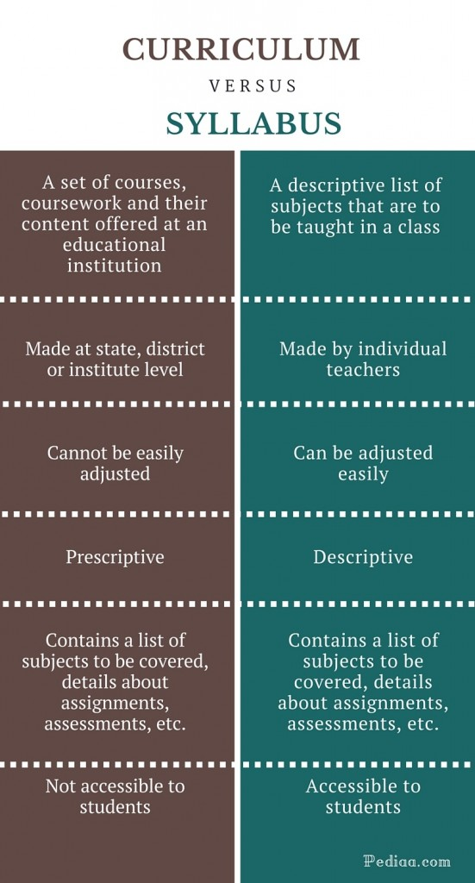
CURRICULUM VS SYLLABUS

Slide 5
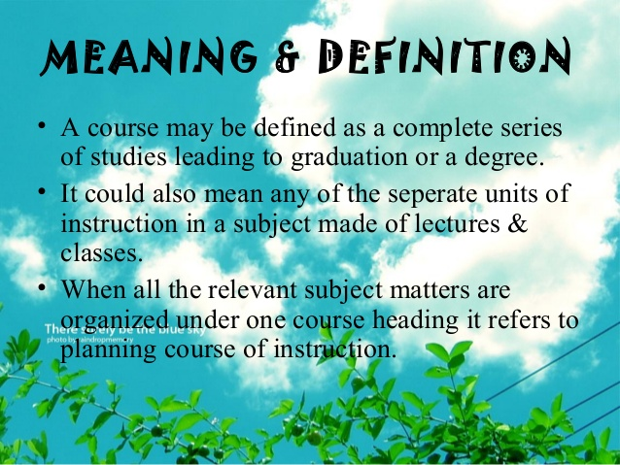
THE COURSE

Slide 6
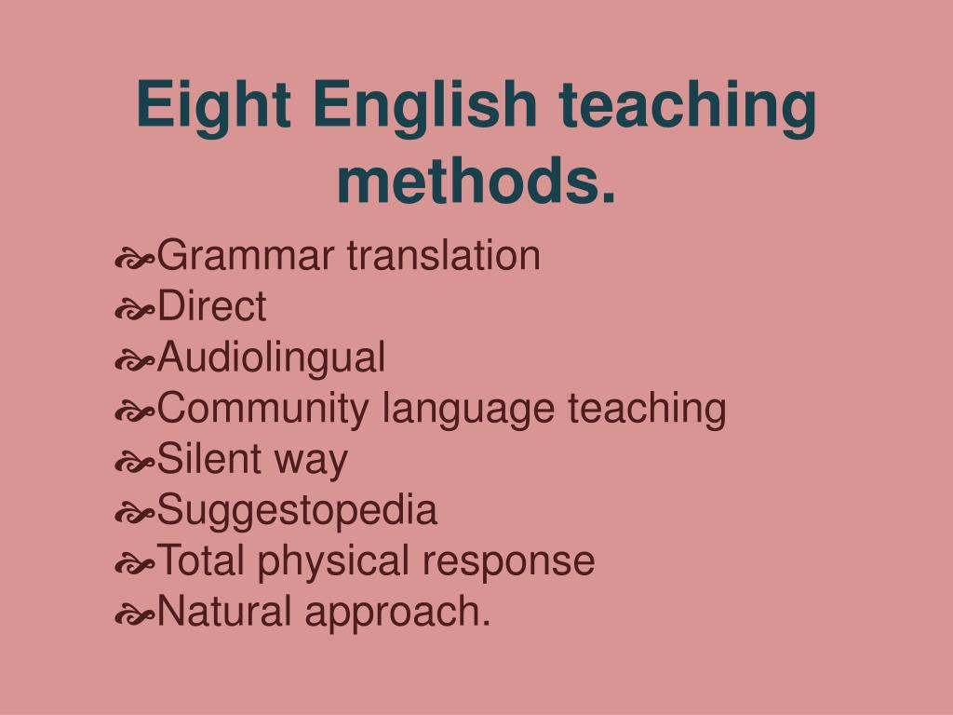
THE CLASSROOM TECHNIQUES

Slide 7

Innovative teaching methods:

Slide 8
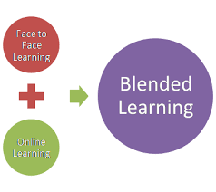
BLENDED LEARNING

Slide 9
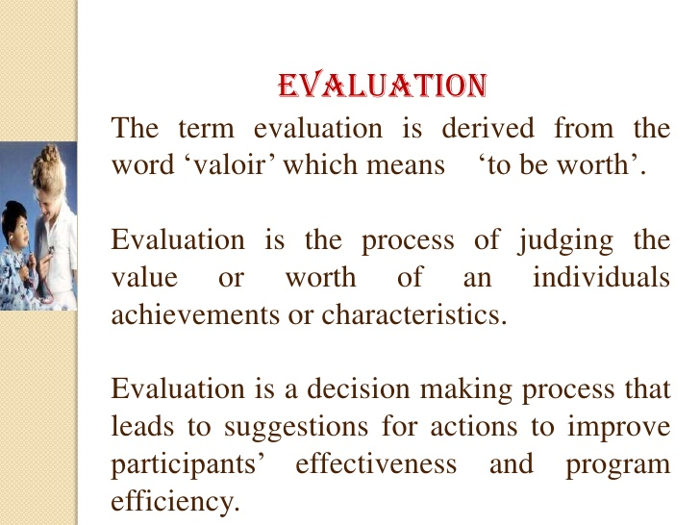
THE SYSTEM OF EVALUATION

Slide 10
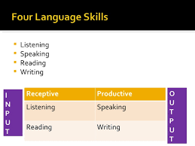
FOUR SKILLS OF LANGUAGE LEARNING

Slide 11
PROBLEMS AND PROSPECTS FOR THE TEACHERS OF ENGLISH
Class-room conditions
Lack of audio-visual aids
Lack of good English teachers
Faulty methods of teaching English
Variation in syllabus
Unsuitable text books
Defective Examination system
Defective evaluation procedure
Improper correction
Role of Education Department

Slide 12
Cont...
1.Classroom condition :
*include the number of students in a class,physical arrangements for the class, teaching aids such as chalk,black-board,audio-visual aids, library and the like.
2.Lack of audio-visual aids:
*Many of our schools donot have the simple visual aids like flash cards, charts, blackboard,pictures etc;

Slide 13
Cont...
*3. Lack of good English Teachers:
Many teachers in schools who are teaching English neither have enough knowledge of English nor are familiar with the latest and far-reaching developments in English.
*4. Faulty methods of teaching English:
Most of the English teachers are untrained or ill-trained. The new approaches are not popular with our teachers.

Slide 14
Cont...
*5.Variation in Syllabus:
In India the educational system is not uniform. So there is variation in syllabus. The variation results in differences in achievement.
*6.Unsuitable Textbooks:
The text books that are prescribed to our students are not suitable and attractive. Students read them only to pass the examination. Oral work is much neglected.

Slide 15
Cont...
7.Defective examination system:
The examination in English puts a lot of emphasis on memorising rather than language mastery.
There is no examination in spoken English
Written English is given importance.
8.Defective evaluation procedure:
Evaluation is another drawback.
our question papers are based mainly on essay type questions. So they do not test all the four skills of language learning.

Slide 16
Cont…
9.Improper Correction:
Teachers, due to various reasons, do not properly correct the exercise books of students.
10.Role of Education Department:
The Education Department should make provision for effective supervision English teaching in schools.

Slide 17
THE PROBLEMS THAT ARE FACED BY A SECOND LANGUAGE LEARNER
1.Teacher’s knowledge of student
2. Imitation
3. Practice and Drill
4. Oral approach
5. Selection and Gradation
6. Motivation
7. Interference of mother tongue

Slide 18
1.Teacher’s knowledge of student:
While teaching, the teacher must keep in mind the learner.
He should know the capability and capacity of the student to learn and above all his environment of learning
2. Imitation:
Learning a language is based on the principle of imitation.
In fact imitation is natural to man.
if a teacher has poor pronunciation the students will pick up the same poor standard of pronunciation from him.
3.Practice and Drill:
Learning a language is a habit of formation process.
Habits are formed through repetition.
But in our schools/colleges practice and drill work are needed for it.

Slide 19
4.Oral approach:
In our school students are not exposed to oral approach.
Only oral work introduces activity and encourages the learners to speak.
5.Selection and Gradation:
In respect of vocabulary, grammar items and structures, selection and gradation are not done in our schools.

Slide 20
6.Motivation:
Language is quickly learnt if interest and motivation are created.
The teachers should motivate the students to have interest both in the teacher and the subject matter.
7.Interference of mother tongue:
The interference of the mother tongue makes the foreign language lose its originality , nativity and beauty.
We find the mother tongue of the Indian learners affecting their pronunciation.

Slide 21
Cont...
Asset language:
In society English is considered as an asset
Language.
The highly educated and sophisticated section of the society find it prestigious to converse in English.
It will boost up their image.

Slide 22
Window on the modern world:
English is the window which opens up the vast prospect of human achievements
Nehru admitted that English is our major window to the modern world.

Slide 23
Link language:
English is a link language in India.
Throughout the country the educated people understand only this language.
Without a fair knowledge of English there can be no dialogue between persons from different States.

Slide 24
Cont..
Library language:
Kothari Commission (1964-1966) suggested that English should be made the lib.lang.in our country.
It has a store house of rich vocabulary.
About 60% of the books in the field of science and Tech. are in English.

Slide 25
Cont...
Language of opportunities:
A person With knowledge of English stands a good chance of employment anywhere and everywhere in the world.

Slide 26


